Slide 1
Is “fake news” real?
Fake News, Information & Libraries
November 9, 2019
Anne Johnson, U.S. Embassy Rome

Slide 2
Disinformation
False information deliberately and often covertly spread (as by the planting of rumors) in order to influence public opinion or obscure the truth (Merriam-Webster)

Slide 3
Examples of disinformation

Slide 4
Examples of disinformation

Slide 5
Let’s watch this
VOA NEWS
https://learningenglish.voanews.com/a/news-litaracy-introduction-news-through-time/4387984.html

Slide 6
Critical thinking
“Critical thinking is the intellectually disciplined process of actively and skillfully conceptualizing, applying, analyzing, synthesizing, and/or evaluating information gathered from, or generated by, observation, experience, reflection, reasoning, or communication, as a guide to belief and action.” (The Foundation for Critical Thinking)
Critical thinking is the objective analysis and evaluation of an issue in order to form a judgment (Oxford Dictionary)
Critical thinking is the analysis of facts to form a judgement (Wikipedia)

Slide 7
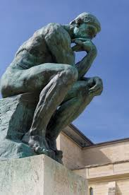
Critical thinking
The great majority of men and women, in ordinary times, pass through life without ever contemplating or criticizing, as a whole, either their own conditions, or those of the world at large.
-Bertrand Russell

Slide 8
Critical thinking
Someone with critical thinking skills can:
Understand the links between ideas.
Determine the importance and relevance of arguments and ideas.
Recognize, build and appraise arguments.
Identify inconsistencies and errors in reasoning.
Approach problems in a consistent and systematic way.
Reflect on the justification of their own assumptions, beliefs and values.
Read more at: https://www.skillsyouneed.com/learn/critical-thinking.html

Slide 9
Critical thinking
WHY IS IT IMPORTANT?
Fosters independent thinking and problem-solving
Is an important element in creativity and innovation
Encourages curiosity and lifelong learning
Enables finding alternative solutions to problems
Aides strategic thinking and planning
Enables rational thinking and logical presentation of ideas

Slide 10
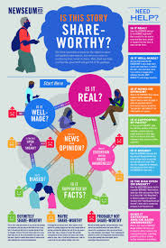
WHAT CAN LIBRARIES DO?
RAISE AWARENESS:
Through targeted campaigns (aimed at a specific audience), such as during literacy months
Posters which highlight the importance of information/media or digital literacy
Online campaigns using social media
Offer public programs with qualified speakers

Slide 11
What can libraries do?
TRAINING FOR THE PUBLIC:
Offer training to teens on information/media literacy
Offer training to university students
Offer training to the general public (consider social media training for older adults and include ways to spot misinformation or media manipulation)

Slide 12
What can libraries do?
MODEL MAINTAINING BALANCED VIEWS:
Have a collection policy that supports a wide variety of viewpoints
Offer a variety of resources in collections (both print and digital collections)

Slide 13
What can libraries do?
COLLABORATE:
With different organizations and individuals to offer quality programs and training for media literacy, such as:
NGOs with expertise
Government entities (national to local)
University journalism, communication or media studies programs
Schools
Media outlets/journalists
Library Associations

Slide 14
Library associations and media literacy
IFLA: https://www.ifla.org/publications/ifla-media-and-information-literacy-recommendations
IFLA Guidelines on Media Literacy: https://www.ifla.org/FR/publications/node/67341?og=7407
ALA: http://www.ala.org/tools/programming/post-truth-fake-news-and-new-era-information-literacy

Slide 15
What else can libraries do?
CREATE YOUR OWN MEDIA LITERACY PROGRAM:
Design a media literacy workshop for your library, using the A-F Communications Model
Decide on the audience, the content and who could conduct the workshop
You have 30 minutes to design the outline of your training

Slide 16
A-f communication model
Audience
Behavior
Content
Delivery
Evaluation
Follow-up

Slide 17
Who would like to share their workshop idea?

Slide 18
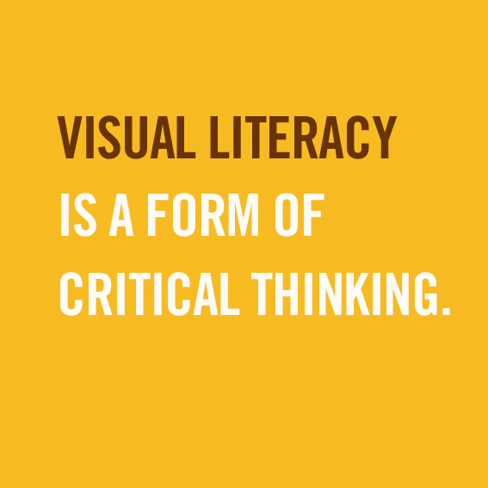
Visual literacy
VISUAL LITERACY is the ability to recognize and understand ideas conveyed through visible actions or images (such as pictures)
(Merriam Webster Dictionary)
Notes:
I thought we could spend a few minutes looking a visual literacy, which is an important aspect of information literacy. We’ve all heard the expression a picture is worth a thousand words, and it’s true. An image can convey so much and be more emotive than words. They can make you cry, laugh, astound you. In other words, they can be manipulative.

Slide 19
Visual literacy
https://www.youtube.com/watch?v=2jR8zWqyHBY

Slide 20
Is it real?
Notes:
Source: BuzzFeed

Slide 21
Is it real?
Notes:
Source: BuzzFeed

Slide 22
Is it real?
Notes:
Source: BuzzFeed

Slide 23
Is it real?
Notes:
Source: BuzzFeed

Slide 24
Is it real?

Slide 25
Is it real?

Slide 26
IS IT REAL?
Notes:
Source: BuzzFeed

Slide 27
Is it real?
Notes:
Source: BuzzFeed

Slide 28
Is it real?

Slide 29
Visual literacy tips
TIPS ON HOW TO TELL IF AN IMAGE IS REAL OR NOT:
Look for poorly worded text, rough edges within the image, or strange cropping or camera angles — all of these can indicate that the image was edited.
Ask yourself where this image comes from and see whether or not other news outlets have also shared the image.
Think about the story a photo is trying to paint. Does it seem credible? Is it believable or far-fetched?
Is it easy to identify when and where the photo was taken?
Notes:
Source: Arizona State University News Co/Lab

Slide 30
Visual literacy resources
RESOURCES:
Google Reverse Search Image (Search Engine) You can Google search an image and the results will display similar images and websites that contain the same images
Snopes (Website)
Fact checks text and images
Tineye (Website) When users upload an image to TinEye, the site reverse image searches to find duplicates and scours the internet for other sites where the image occurs.

Slide 31
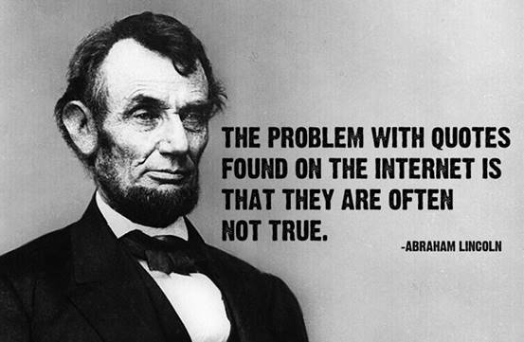
Visual literacy resources
Truepic (App)
Media consumers can use this free app to validate photos and videos from the internet. It uses computational techniques to determine whether pixels or metadata seem altered.
Notes:
Source: Arizona State University News Co/Lab

Slide 32
Deepfakes
The next frontier of disinformation: deepfakes (AI-generated videos designed to fool humans)
Being used to discredit politicians, celebrities and CEOs, eg. algorithmically transplanted facial features and audio deepfakes
The new focus of propaganda
Technology is developing faster than tech experts can create detection mechanisms
Financial Times Magazine, Oct 23, 2019
Notes:
Source: Financial Times Magazine, Oct 23, 2019
“Can you believe your eyes? How deepfakes are coming to politics.”

Slide 33
resources
THANK YOU!
DO YOU HAVE ANY QUESTIONS or COMMENTS?
See Resources handout

